Slide 1


Airline Ticket Reservation System
Presented By :
Mr. Atul Kumar(210941220035)
Mr. Ankit Sachan(210941220025)

Slide 2
Points to be discussed
Introduction
Motivation
Objective
UML Diagram
Screenshots
Specifications
S/W and H/W used
Advantage
Disadvantage
Conclusion
Future enhancement
GitHub Link
References

Slide 3
Introduction
Airline Reservation System is software which is helpful for ticketing manager as well as the customers. In the later system all the activities were done manually. It was very time consuming and costly. Our Airline Reservation System deals with the various activities related to the flights.
There are mainly 3 modules in this software :
1.Search flights
2.Flight reservation
3.Add/Delete flights

Slide 4
Motivation
The main purpose of this study is to automate the manual procedures of reserving a flight ticket for any journey made through Any Transport Company . This system is said to be an automatic system and customers can select their seats. Specifically, objectives of this project will consist of :
Providing a web-based Airline ticket reservation function where a user can buy airline ticket through the online system without a need to queue up at the counter to purchase a ticket.
Enabling customers to check the availability and types of flights online. Customer can check the time departure for every plane through the system.

Slide 5
Objective
Our software will perform and fulfil all the tasks that any customer would desire. Our software system mainly deals with customers Searching and booking flight in the airlines. The various features added to the project provide all the functions to make the task easy to perform.
System analysis can be categorized into five parts:
System planning and initial investigation
Information Gathering
Applying analysis tools for structured analysis
Feasibility study
Cost/ Benefit analysis.

Slide 6
Technology used
Front-end : ReactJS
Back-end : Java Spring Boot

Slide 7
UML Diagrams

Slide 8
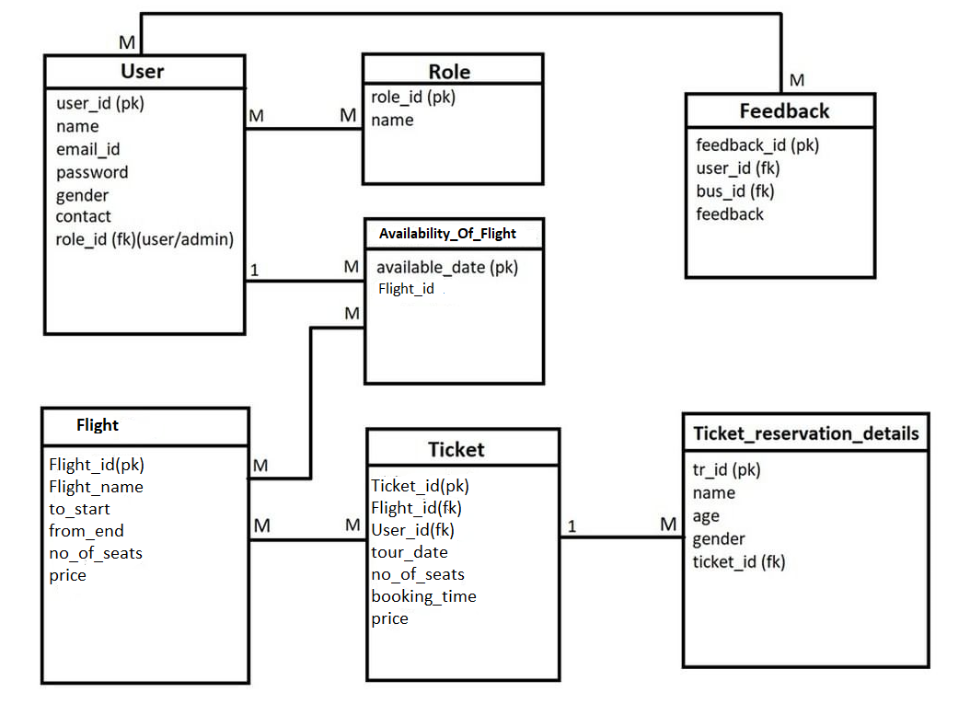
E-R Diagram

Slide 9
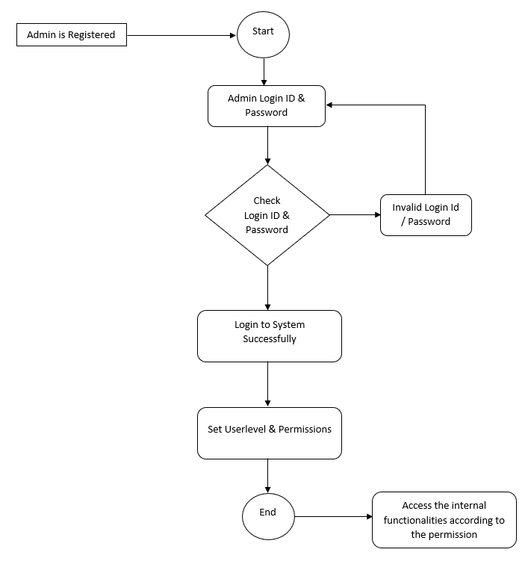
Admin Activity Diagram

Slide 10
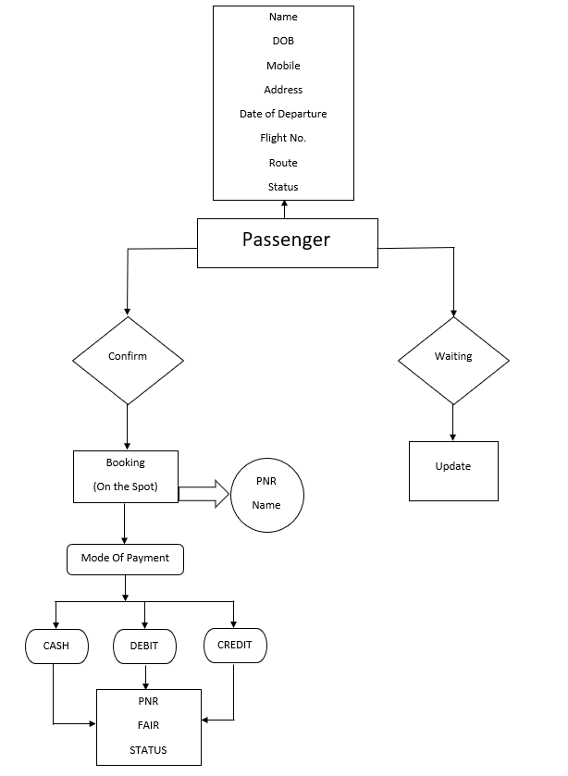
User Activity Diagram

Slide 11
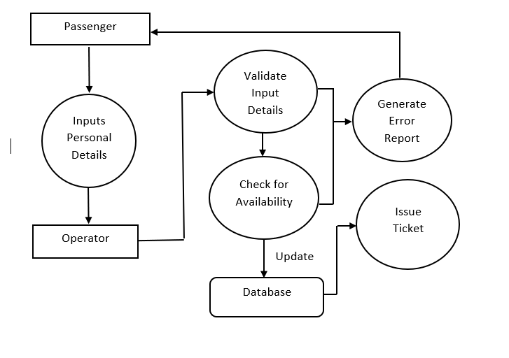
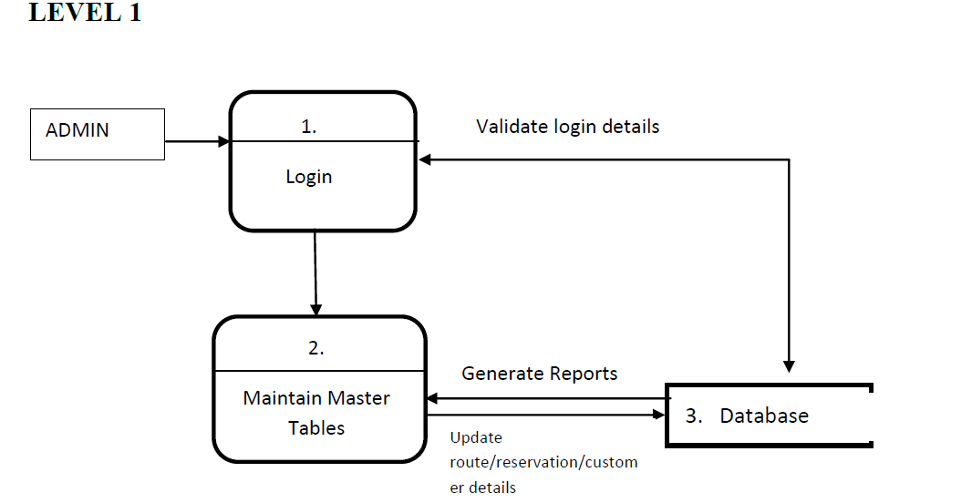
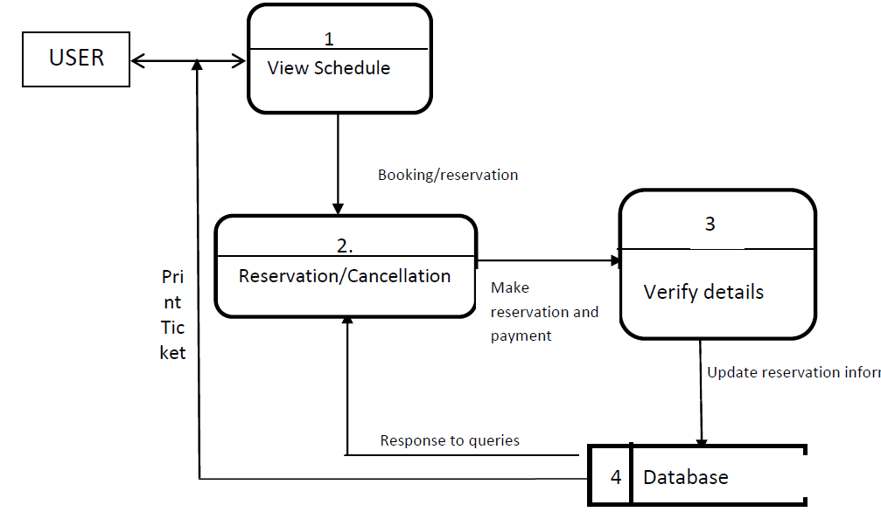
Data Flow Diagram

Slide 12
Screen Shots

Slide 13
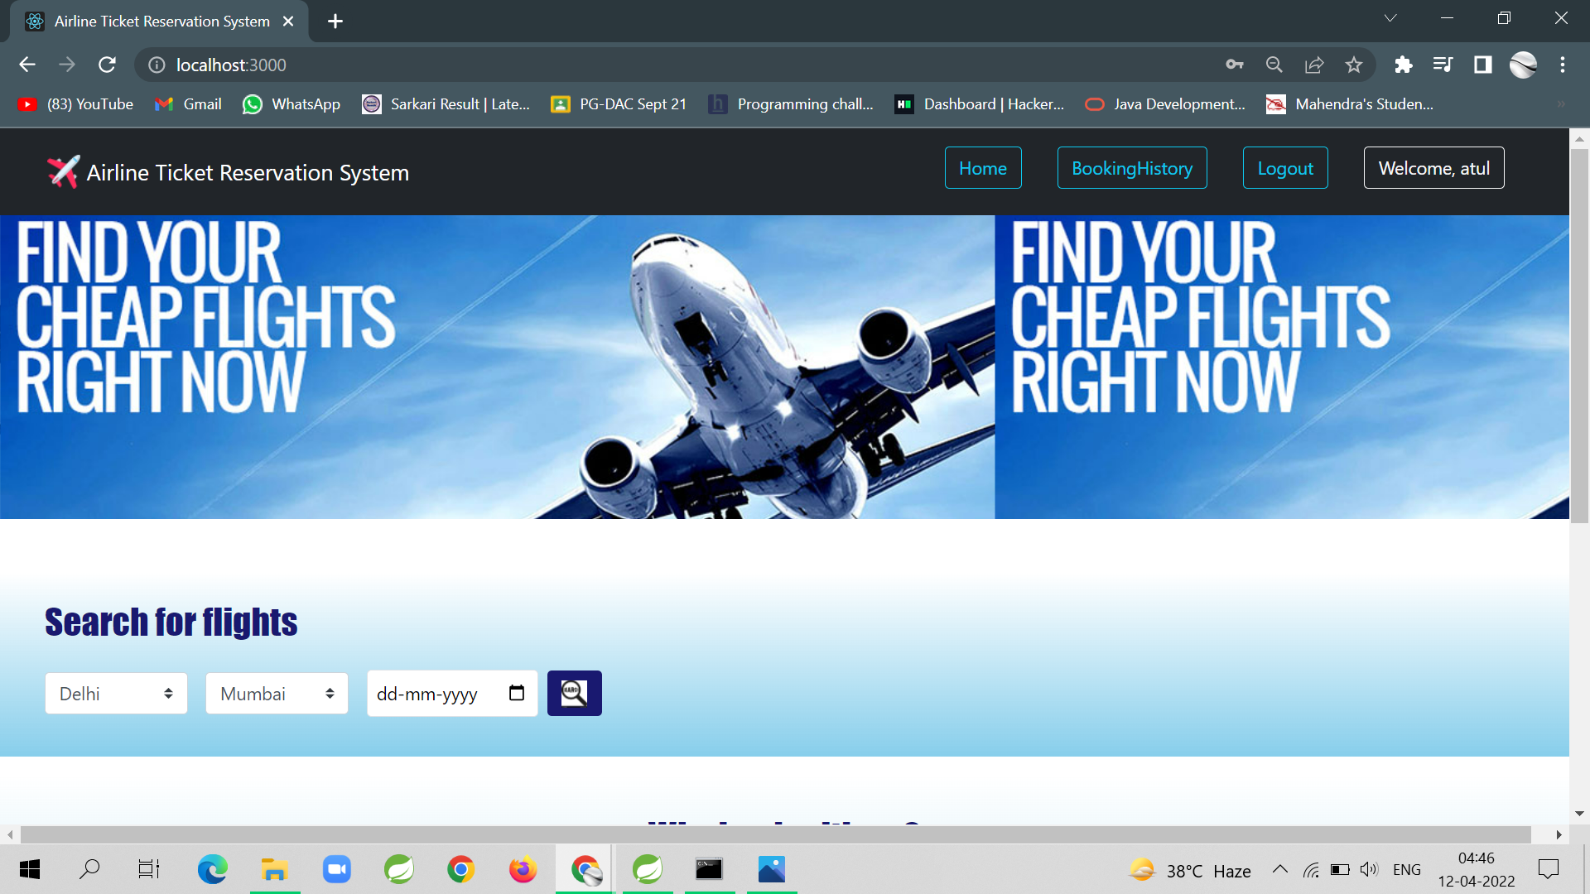
Front Page

Slide 14
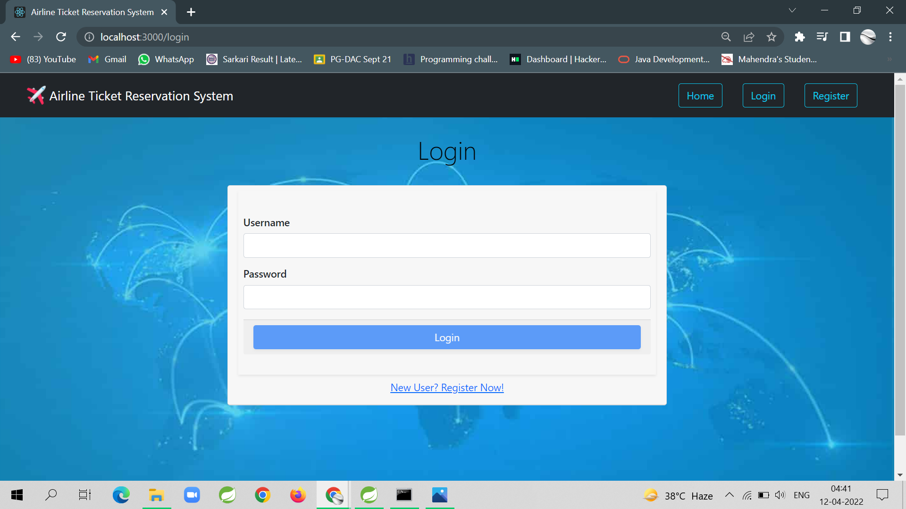
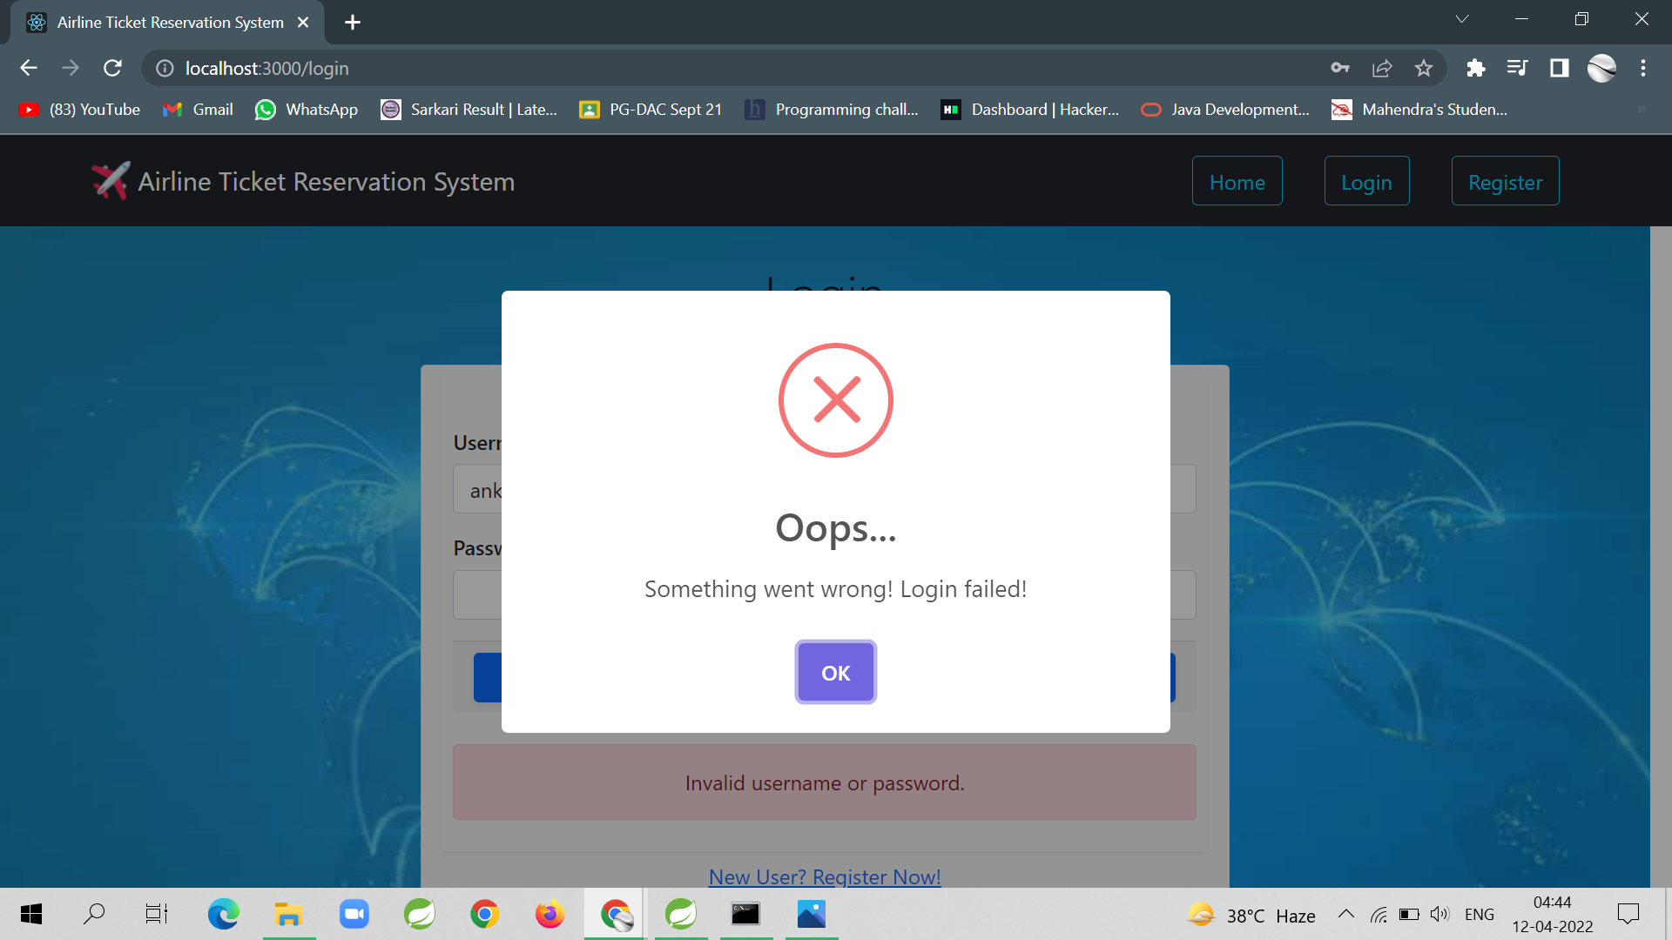
Login Wrong Login

Slide 15
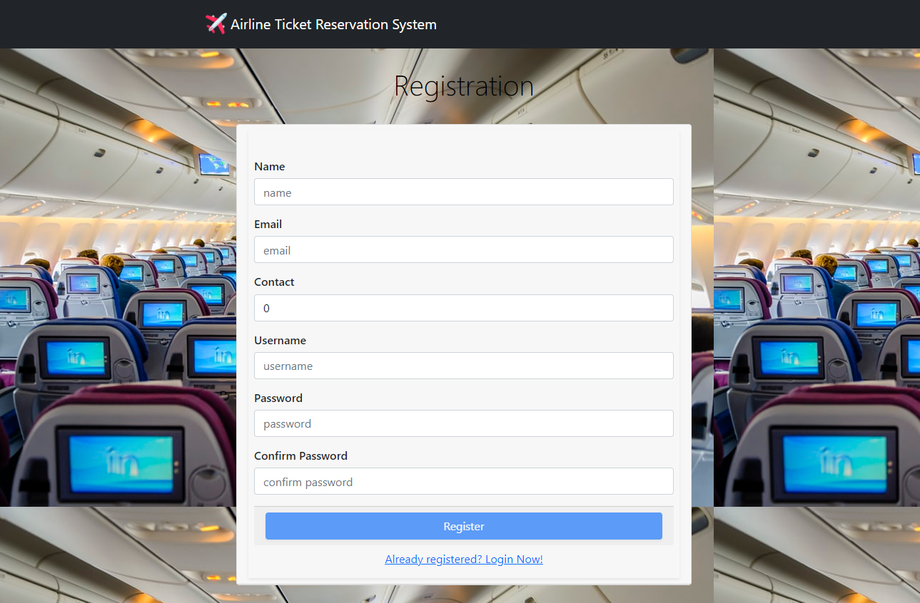
Registration

Slide 16
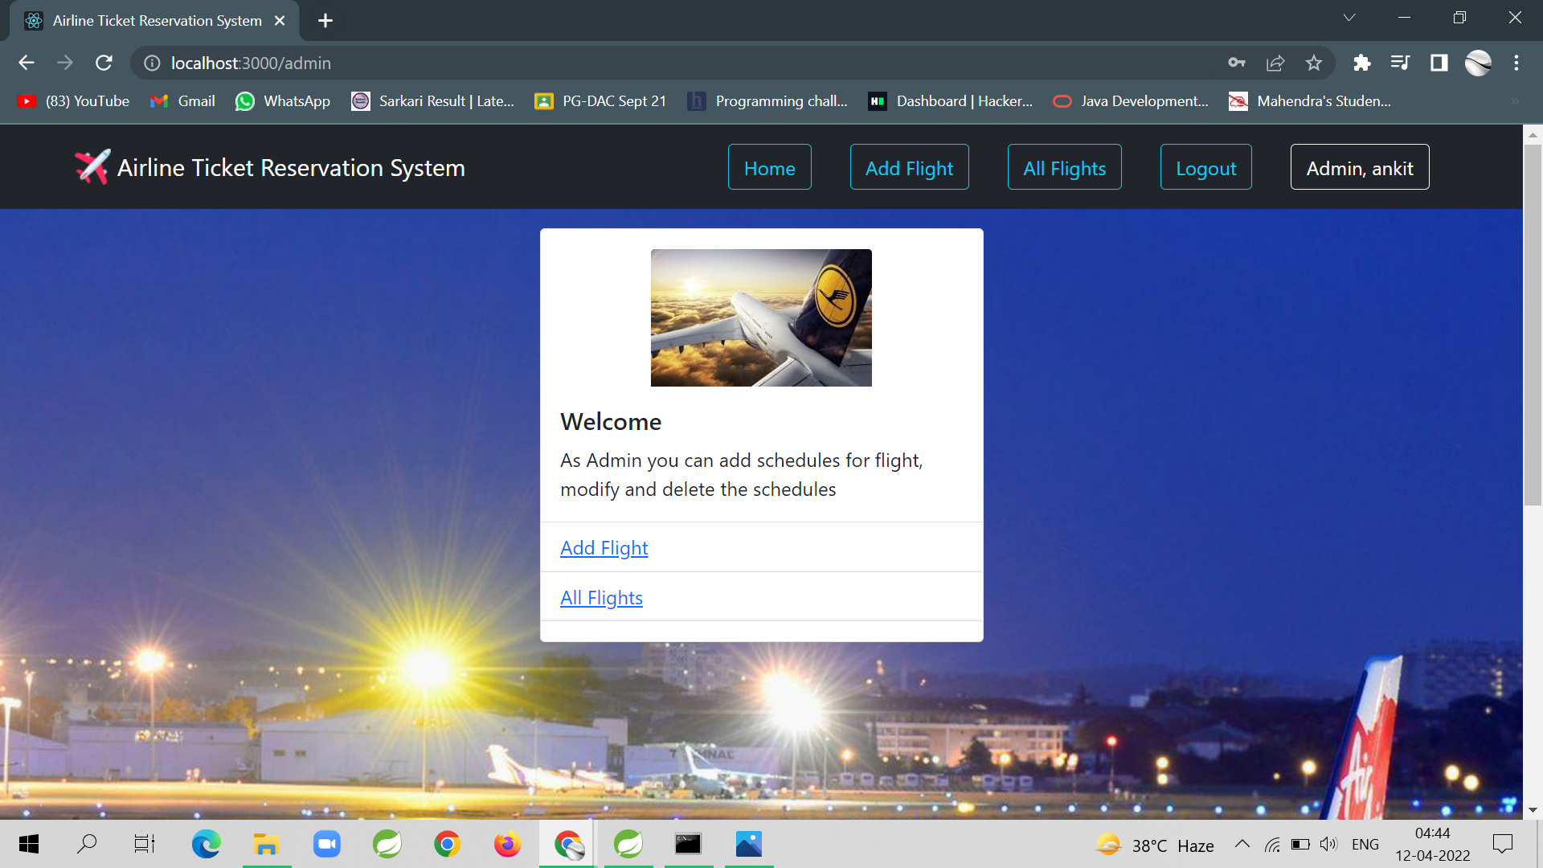
Admin Login

Slide 17
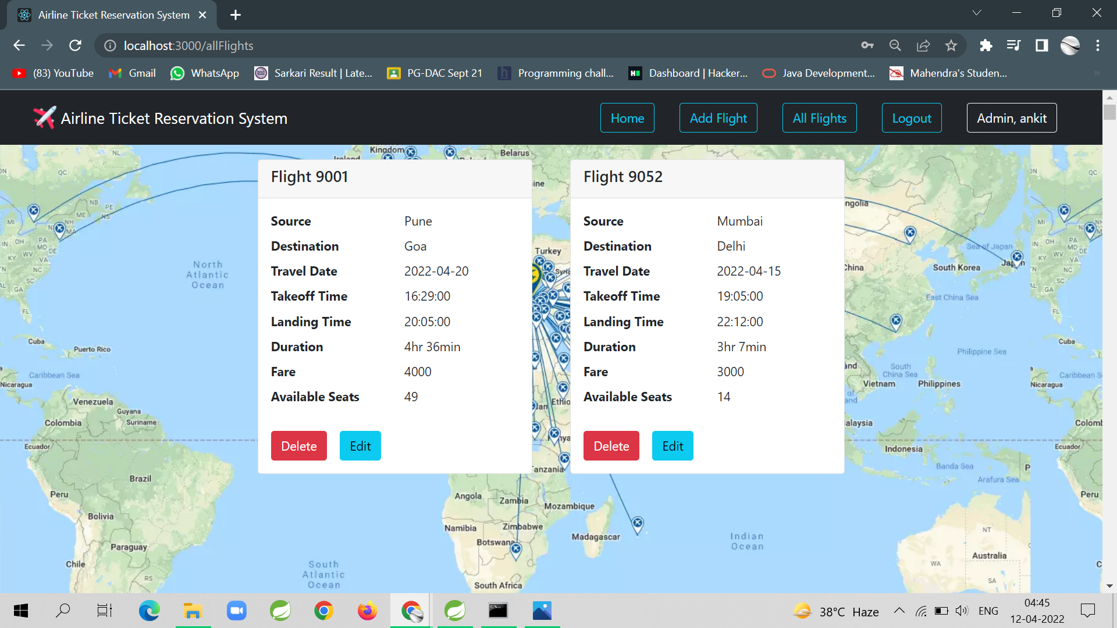
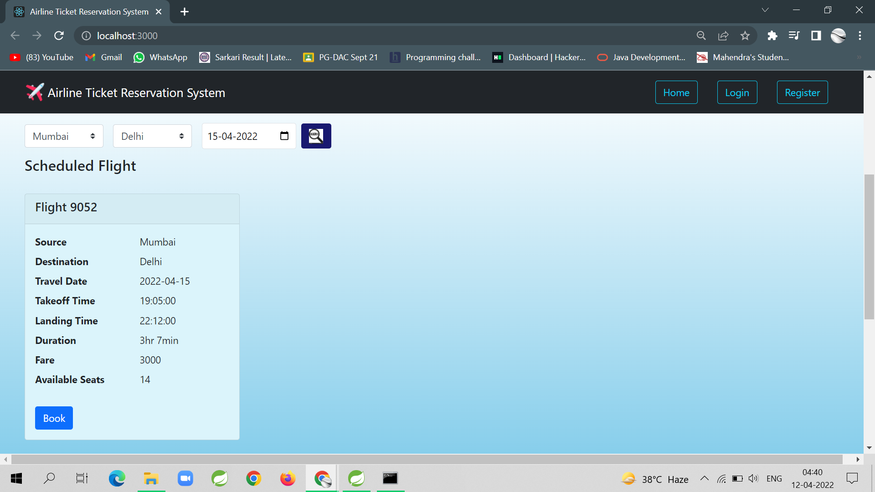
All flight Available flight

Slide 18
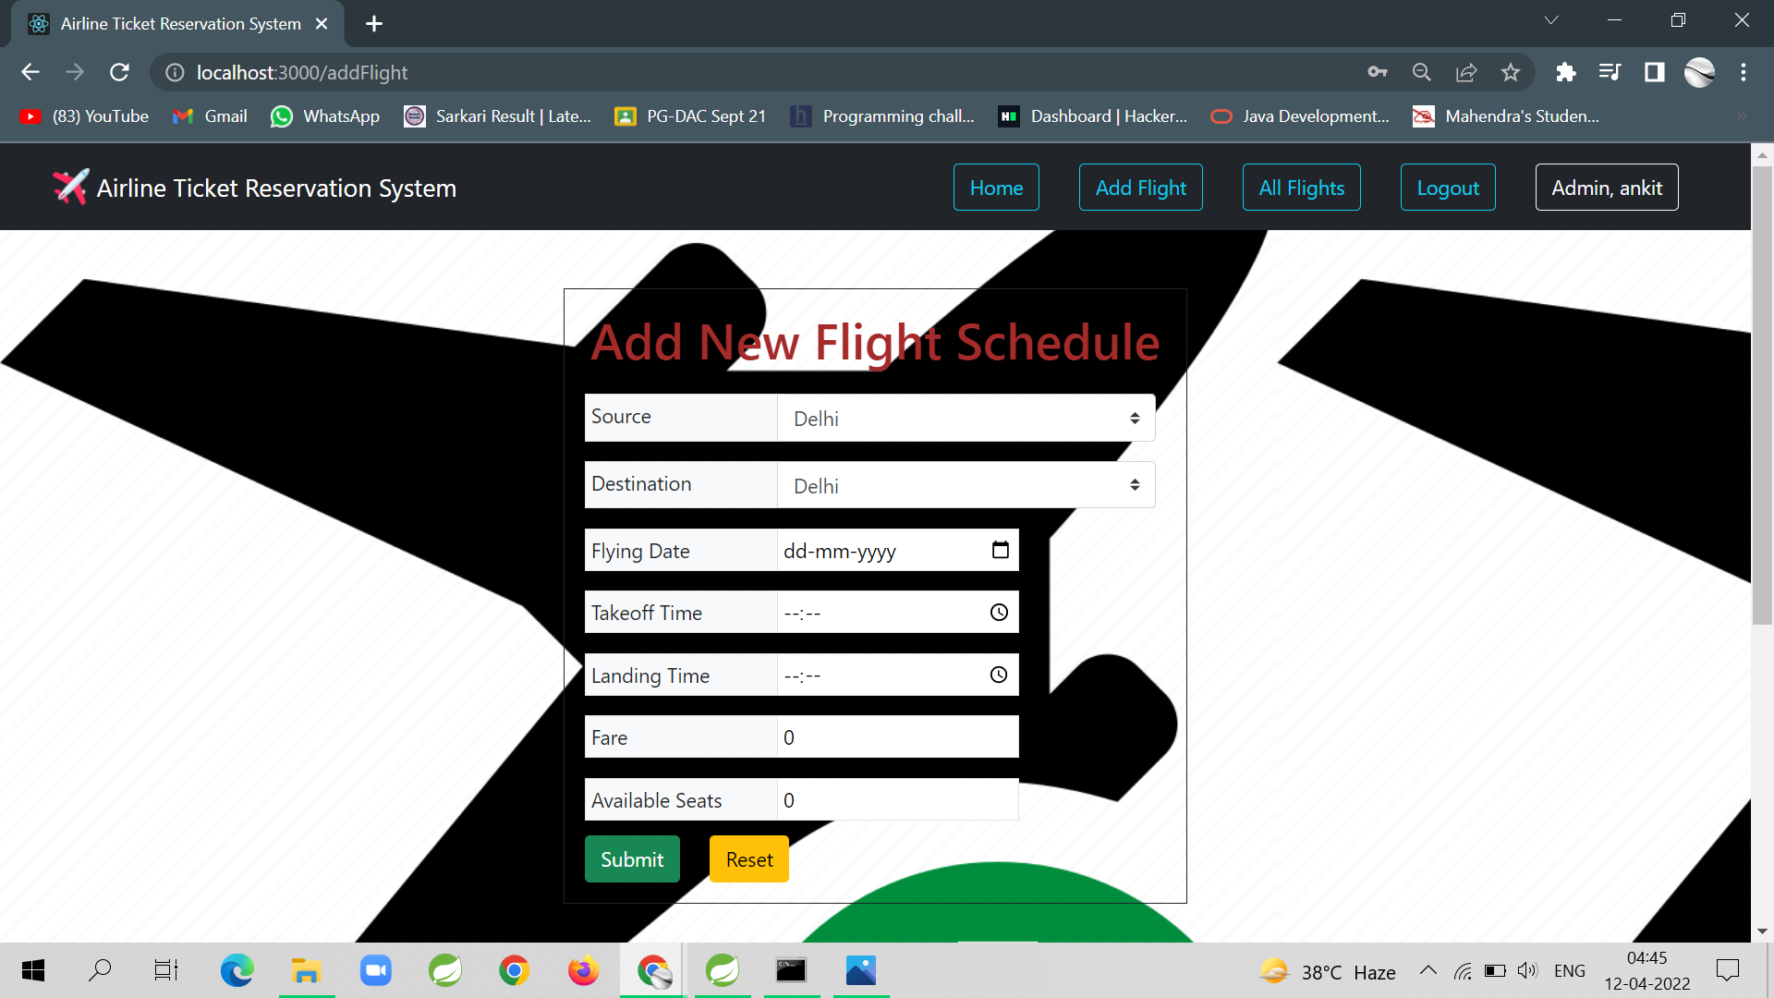
Add Flight

Slide 19
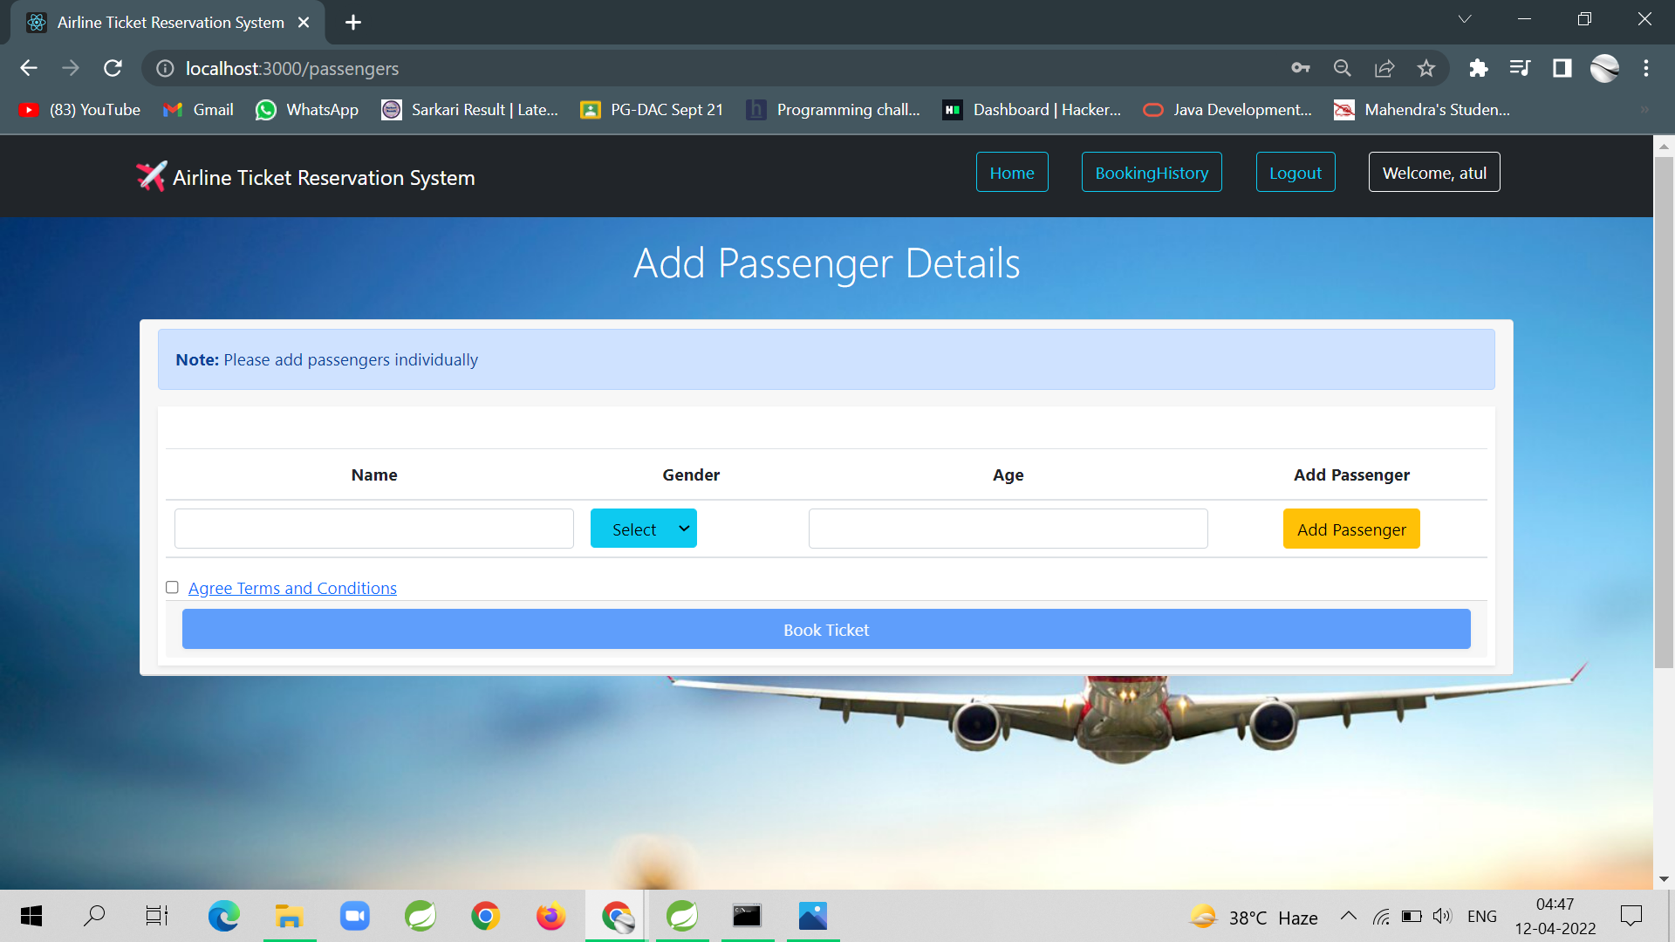
Add Passenger

Slide 20
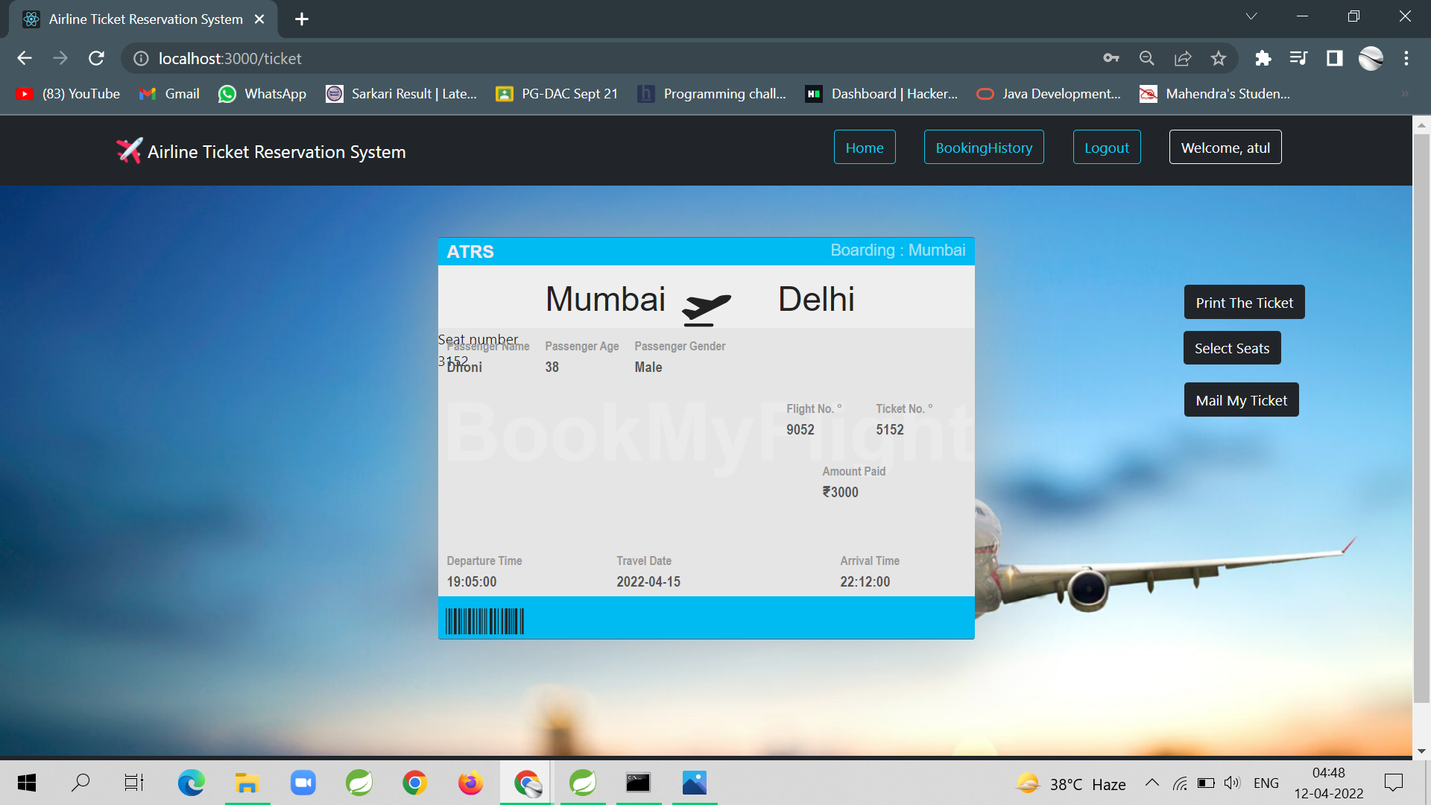
Ticket

Slide 21
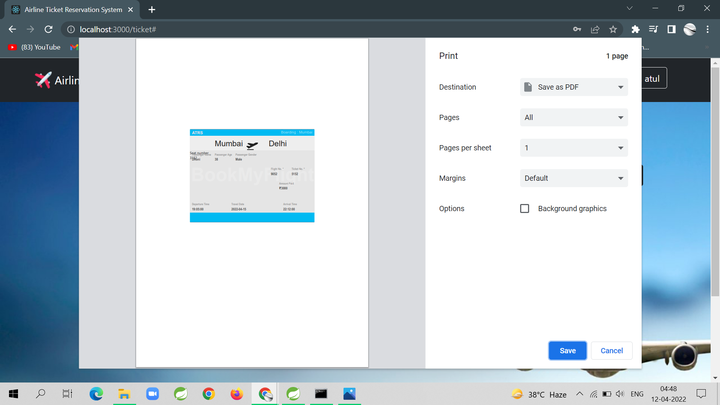
Print Ticket

Slide 22
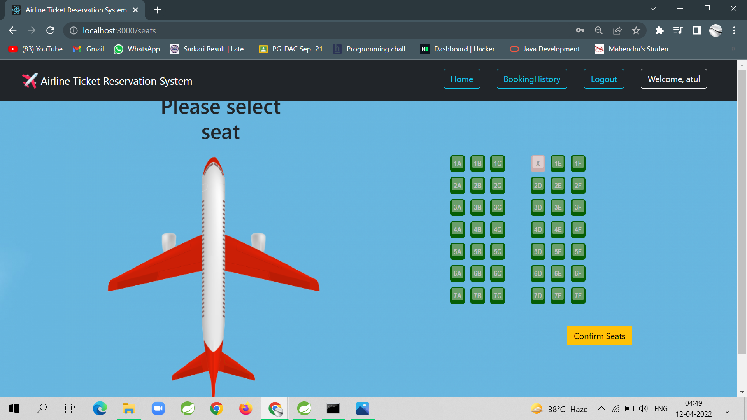
Select Seat

Slide 23
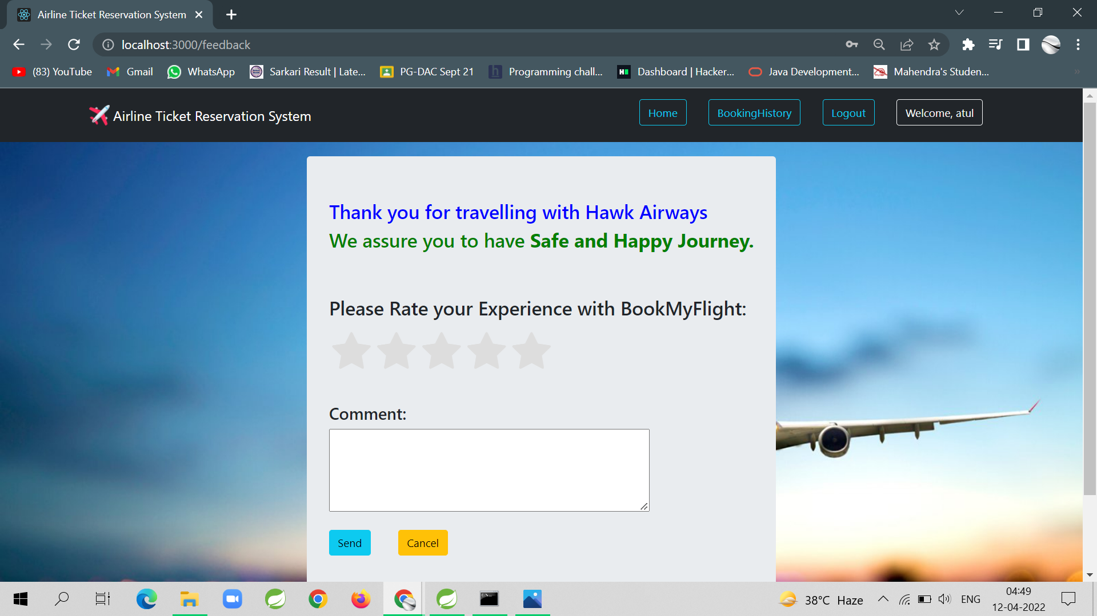
Feedback

Slide 24
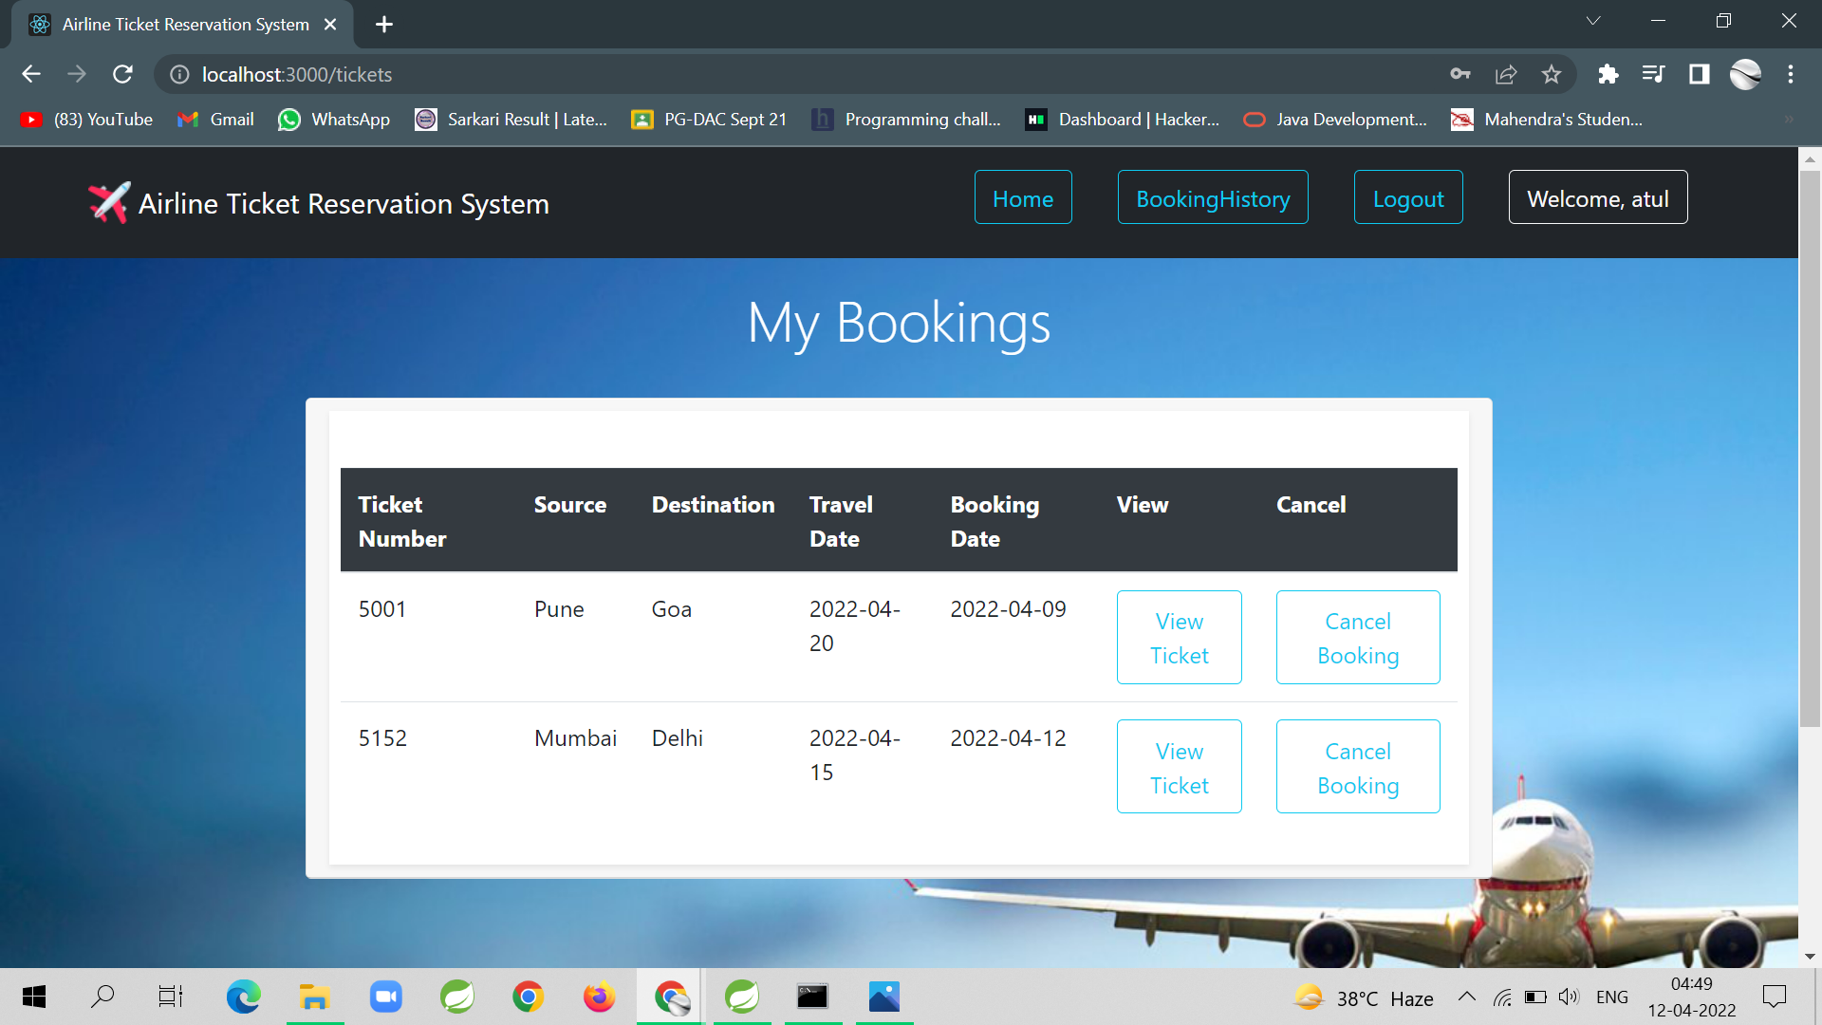
Booking History

Slide 25
Specifications
The application will use Java spring boot, React and CSS as main web technologies.
The frontend is designed in react and backend is designed using java spring boot .
SMTP protocol is used for Email communication.
Several types of validations make this web application a secured one and SQL Injections can also be prevented.

Slide 26
S/W and H/W Required
Server Side:
Processor: Intel® Xeon® processor 3500 series
HDD: Minimum 500GB Disk Space
RAM: Minimum 4GB
OS: Windows
Database: MySQL
Client Side (minimum requirement):
Processor: Intel Dual Core
HDD: Minimum 80GB Disk Space
RAM: Minimum 2GB
OS: Windows

Slide 27
Advantages
Managing all flight information.
Effortless Communication.
Data storage is easy.
Automatic ticket generation after providing correct details.
Paper work is reduced .
Man power is reduced.
All requirements at one place.

Slide 28
Disadvantage
Not all the user are aware of using this application.
Admin has to login into database to check passenger list. But this can we done as future enhancement .

Slide 29
Conclusion
This project aid in automating the existing manual system. This is a paperless work. It can be monitored and guarded remotely. It cut down the man power required and provides accurate information. All years together huddled information can be saved and can be accessed at any time. For this reason, the data stored in the repository helps in taking decision by management. So, it is improved to have a Web Based system. Admin and user can get the required information without delay. This system is crucial in the travelling booking business.

Slide 30
Future Enhancement
This project can be enhanced further by adding international flights, passenger list for the members to reduce the extra work of the admin.
The software is flexible enough to be modified and implemented as per future requirements.
We have tried our best to present this free and user–friendly application for ticket booking.

Slide 31
References
http://www.ijcstjournal.org/volume-7/issue-1/IJCST-V7I1P4.pdf
https://bootstrapmade.com
https://www.javatpoint.com/java-mail-api-tutorial
https://angular.io/docs
https://javaee.github.io/javaee-spec/javadocs/
https://www.w3schools.com/

Slide 32
THANK YOU

